Slide 1
SEM Lens Aberration: Astigmatism
Amin Cheraghi Shirazi
Jan. 2013
CAMTEC Nanofabrication Workshop

Slide 2
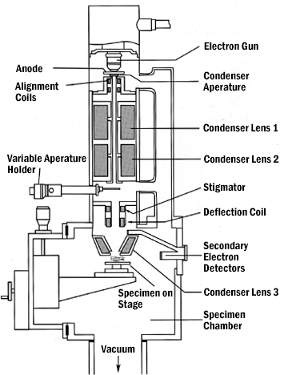
SEM

Slide 3
Lens Aberrations
Spherical Aberration
Chromatic Aberration
Diffraction
Astigmatism

Slide 4
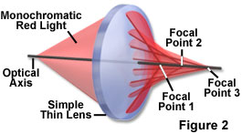
Spherical Aberration

Slide 5
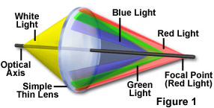
Chromatic Aberration

Slide 6
Diffraction
Electrons wavelengths being out of phase
Lens will focus electrons of different phase to a different point
Monochromatic and Coherent

Slide 7
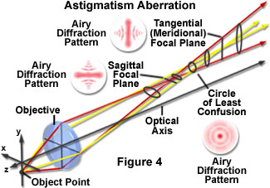
Astigmatism
Non-uniform magnetic field
No perfect cylindrical symmetry

Slide 8
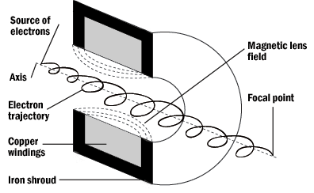
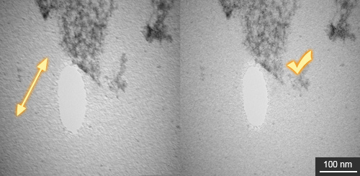
Astigmatism Other Reasons
Micro-structural inhomogeneities
Local variations in the magnetic field strength
Not precisely centered apertures
Apertures contamination

Slide 9
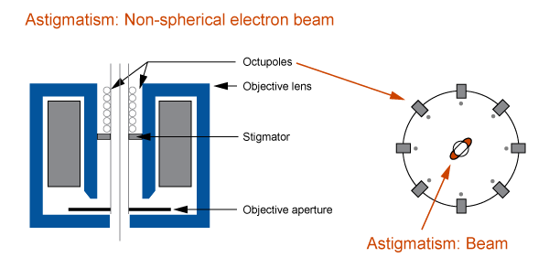
Astigmatism Correction
Stigmators
both in the illumination and imaging system

Slide 10
Thank You!!!

